Slide 1
RCropStat Screen Shots for Design Menu

Slide 2
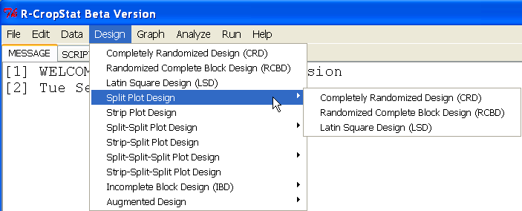

Slide 3
Completely Randomized Design

Slide 4
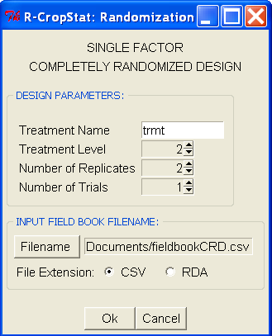
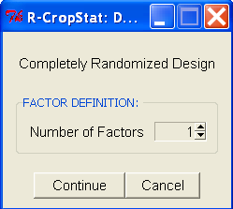
Completely Randomized Design
Case 1: Number of Factors = 1
Initial Dialog box:
Initial values
Note: default filename is CRD.csv
Delete in java version
Starts at 1, spin box but the user can just type a number
Note: For all dialog box with file extension option, this will be deleted in the java version

Slide 5
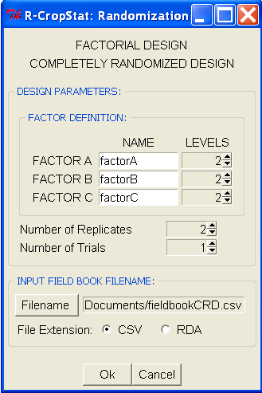

Completely Randomized Design
Case 2: Number of Factors = 3
Note: default filename is CRD.csv

Slide 6
Randomized Complete Block Design

Slide 7
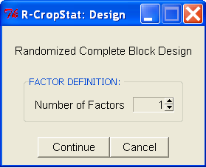
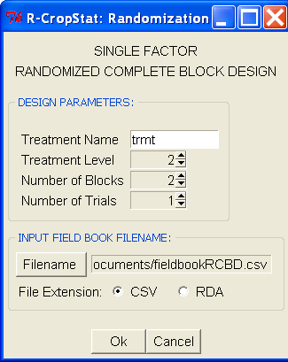
Randomized Complete Block Design
Case 1: Number of Factors = 1
Note: default filename is RCBD.csv

Slide 8
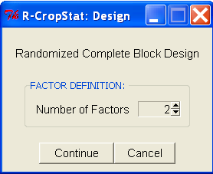
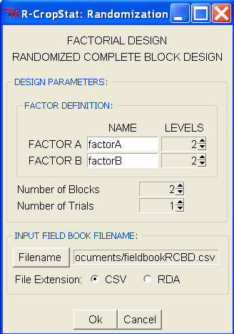
Randomized Complete Block Design
Case 2: Number of Factors = 2
Note: default filename is RCBD.csv

Slide 9
Latin Square Design

Slide 10
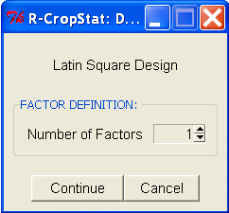
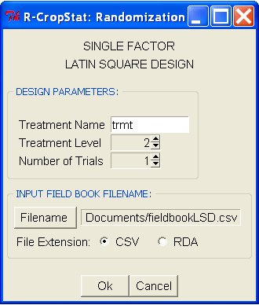
Latin Square Design
Case 1: Number of Factors = 1
Note: default filename is LSD.csv

Slide 11
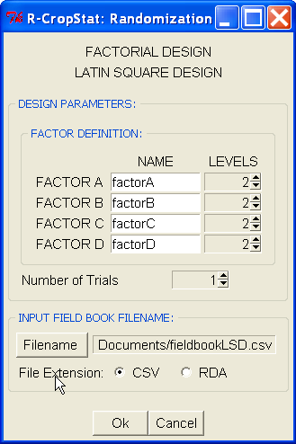
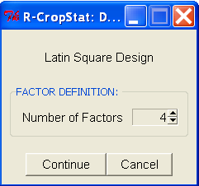
Latin Square Design
Case 2: Number of Factors = 4
Note: default filename is LSD.csv

Slide 12
Split Plot Family of Design

Slide 13
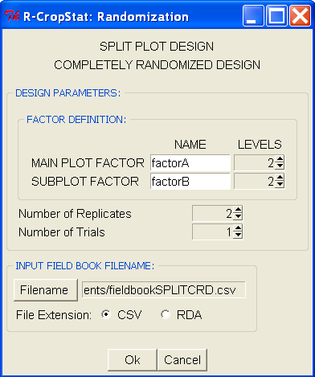
Split Plot in
Completely Randomized Design
Note: default filename is SPLITCRD.csv

Slide 14
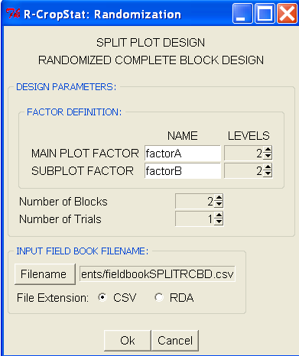
Split Plot in
Randomized Complete Block Design
Note: default filename is SPLITRCBD.csv

Slide 15
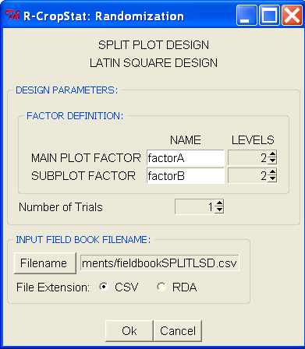
Split Plot in
Latin Square Design
Note: default filename is SPLITLSD.csv

Slide 16
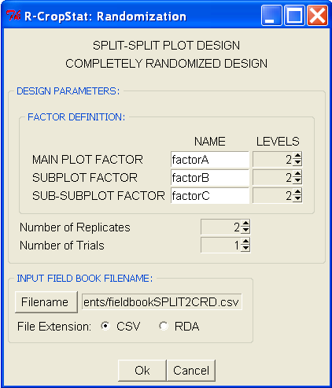
Split-Split Plot in
Completely Randomized Design
Note: default filename is SPLIT2CRD.csv

Slide 17
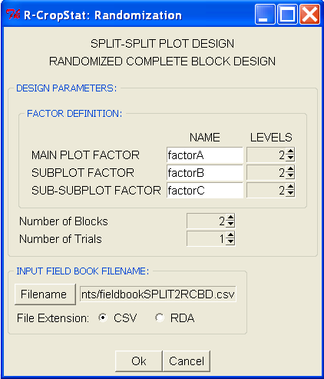
Split-Split Plot in
Randomized Complete Block Design
Note: default filename is SPLIT2RCBD.csv

Slide 18
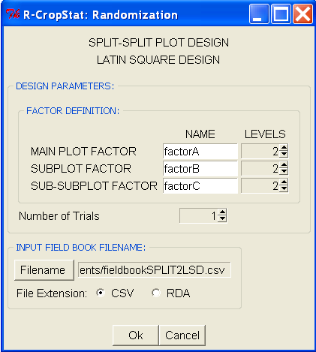
Split-Split Plot in
Latin Square Design
Note: default filename is SPLIT2LSD.csv

Slide 19
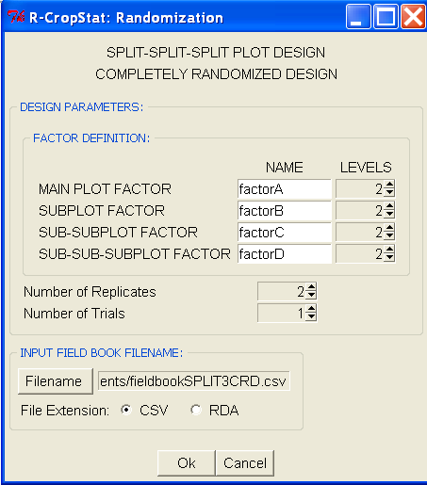
Split-Split-Split Plot in
Completely Randomized Design
Note: default filename is SPLIT3CRD.csv

Slide 20
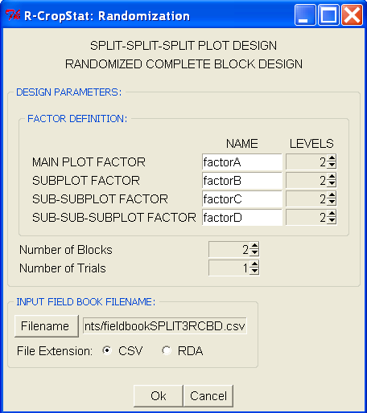
Split-Split-Split Plot in
Randomized Complete Block Design
Note: default filename is SPLIT3RCBD.csv

Slide 21
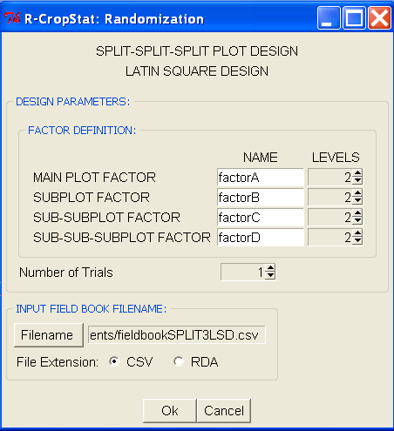
Split-Split-Split Plot in
Latin Square Design
Note: default filename is SPLIT3LSD.csv

Slide 22
Strip Plot Family of Design

Slide 23
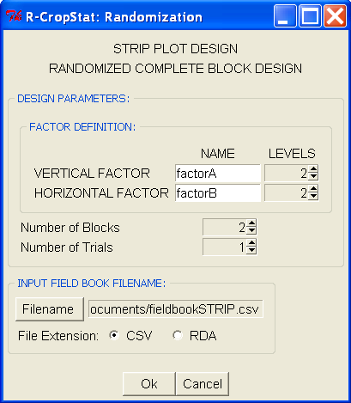
Strip Plot Design
Note: default filename is STRIP.csv

Slide 24
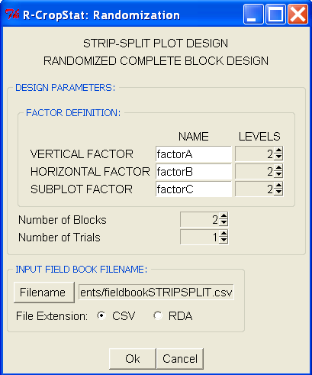
Strip-Split Plot
Design
Note: default filename is STRIPSPLIT.csv

Slide 25
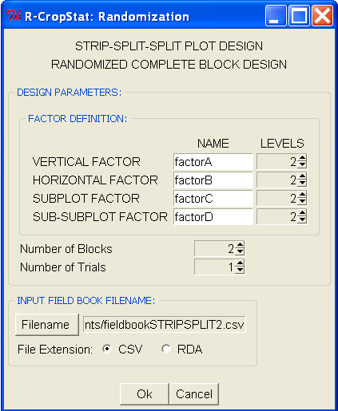
Strip-Split-Split Plot Design
Note: default filename is STRIPSPLIT2.csv

Slide 26
Augmented Design

Slide 27
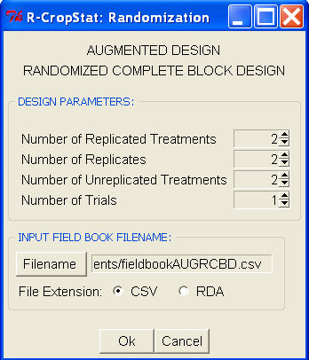
Augmented Design in Randomized Complete Block Design
Note: default filename is AUGRCBD.csv

Slide 28
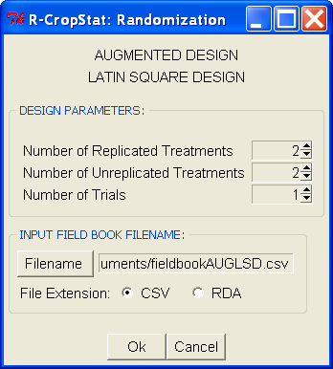
Augmented Design in Latin Square Design
Note: default filename is AUGLSD.csv

Slide 29
Incomplete Block Design

Slide 30
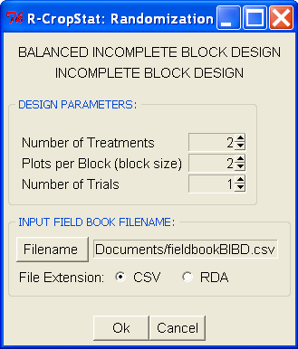
Balanced Incomplete Block Design
Note:
default filename is BIBD.csv
Block size < number of treatments

Slide 31
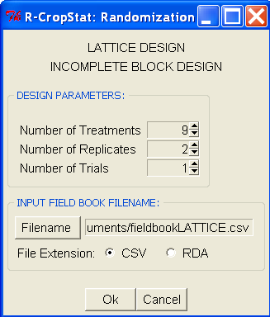
Lattice Design
Note:
default filename is LATTICE.csv
No. of treatments (trmt) should be a perfect square
Max no. of trmt = 144
Case 1: sqrt of no. of trmts is odd, max no. of replicates is sqrt of no. of treatments + 1
Case 2: sqrt of no. of trmts is even,
sqrt # of trmts max # of rep
4 5
8
6 3
10 3
12

Slide 32
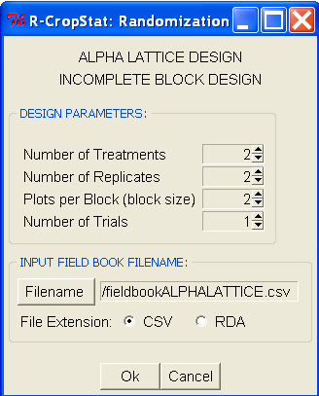
Alpha Lattice Design
Note:
default filename is ALPHA.csv

